Slide 1

Recursion and Backtracking
Using recursion and backtracking, recursion vs Iteration
SoftUni Team
Technical Trainers
Software University
https://about.softuni.bg

Slide 2
Table of Contents
Algorithmic Complexity
Recursion
Backtracking
The 8 Queens Problem
Finding All Paths in a Labyrinth Recursively
Recursion or Iteration?
Harmful Recursion and Optimizing Bad Recursion

Slide 3
O(n)
Algorithmic Complexity
Asymptotic Notation

Slide 4
Algorithm Analysis
Why should we analyze algorithms?
Predict the resources the algorithm will need
Computational time (CPU consumption)
Memory space (RAM consumption)
Communication bandwidth consumption
Hard disk operations

Slide 5
Problem: Get Number of Steps
def get_operations_count(n):
counter = 0
for i in range(n):
for j in range(n):
counter += 1
return counter
Solution:
T(n) = 3(n ^ 2) + 3n + 3
Calculate maximum steps to find the result
The input(n) of the function is the main source of steps growth

Slide 6
Simplifying Step Count
Some parts of the equation grow much faster than others
T(n) = 3(n²) + 3n + 3
We can ignore some part of this equation
Higher terms dominate lower terms – n > 2, n² > n, n³ > n²
Multiplicative constants can be omitted – 12n → n, 2n² → n²
The previous solution becomes ≈ n²

Slide 7
Time Complexity
Worst-case
An upper bound on the running time
Average-case
Average running time
Best-case
The lower bound on the running time (the optimal case)

Slide 8
Time Complexity
Therefore, we need to measure all the possibilities:

Slide 9
Time Complexity
From the previous chart we can deduce:
For smaller size of the input (n) we don't care much for the runtime
So we measure the time as n approaches infinity
If an algorithm must scale, it should compute the result within a finite and practical time
We're concerned about the order of an algorithm's complexity, not the actual time in terms of milliseconds

Slide 10
Asymptotic notations
Descriptions that allow us to examine an algorithm's running time
There are three common asymptotic notations:
Big O – O(f(n))
Big Theta – Θ(f(n))
Big Omega – Ω(f(n))

Slide 11
Asymptotic Functions
Below are some examples of common algorithmic grow:

Slide 12
Typical Complexities
Complexity | Notation | Description
constant | O(1) | n = 1 000 → 1-2 operations
logarithmic | O(log n) | n = 1 000 → 10 operations
linear | O(n) | n = 1 000 → 1 000 operations
linearithmic | O(n*log n) | n = 1 000 → 10 000 operations
quadratic | O(n2) | n = 1 000 → 1 000 000 operations
cubic | O(n3) | n = 1 000 → 1 000 000 000 operations
exponential | O(n^n) | n = 10 → 10 000 000 000 operations

Slide 13

Recursion
What is Recursion?

Slide 14
What is Recursion?
Method of solving a problem where the solution depends on solutions to smaller instances of the same problem
A common computer programing tactic is to divide a problem into sub-problems of the same type as the original, solve those sub-problems, and combine the results

Slide 15
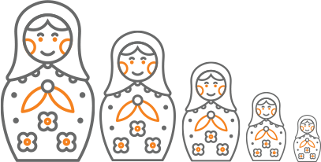
What is Recursion?
A function or a method that calls itself one or more times until a specified condition is met
After the recursive call the rest code is processed from the last one called to the first

Slide 16


Call Stack
"The stack" is a small fixed-size chunk of memory (e.g. 1MB)
Keeps track of the point to which each active subroutine should return control when it finishes executing
Call Stack
call
call
Method A
Method B
Main
Method A
Method B
Main
return
return

Slide 17
Other Definition
Problem solving technique (In CS)
Involves a function calling itself
The function should have a base case
Each step of the recursion should move towards the base case
sum(array)
array[0] + sum(sub-array)
1 | 2 | 3 | 4 | 5
1
2 | 3 | 4 | 5

Slide 18
Array Sum – Example
sum(n)
sum(n - 1)
1 | 2 | 3 | 4
1
2 | 3 | 4
sum((n – 1) - 1)
1
2
3 | 4
sum(((n – 1) - 1) – 1)
1
2
3
4

Slide 19
Problem: Array Sum
Create a recursive method that
Finds the sum of all numbers stored in an array
Read numbers from the console
1 2 3 4
10
-1 0 1
0

Slide 20
Solution: Array Sum
def calc_sum(numbers, idx):
if idx == len(numbers) - 1:
return numbers[idx]
return numbers[idx] + calc_sum(numbers, idx + 1)
Base case
Recursive call

Slide 21
Problem: Recursive Factorial
Create a recursive method that calculates n!
Read n from the console
5
120
10
3628800

Slide 22
Recursive Factorial – Example
Recursive definition of n! (n factorial):
n! = n * (n–1)! for n > 0
0! = 1
3!
3 * 2!
2!
2 * 1!
1!
1 * 0!
0!
1

Slide 23
Solution: Recursive Factorial
def get_factorial(num):
if num == 0:
return 1
return num * get_factorial(num - 1)
Base case
Recursive call

Slide 24
Direct and Indirect Recursion
Direct recursion
A method directly calls itself
Indirect recursion
Method A calls B, method B calls A
Or even A → B → C → A

Slide 25
Recursion Pre-Actions and Post-Actions
Recursive methods have three parts:
Pre-actions (before calling the recursion)
Recursive calls (step-in)
Post-actions (after returning from recursion)
def recursion() # Pre-actions
recursion()
# Post-actions

Slide 26
Problem: Recursive Drawing
Create a recursive method that draws the following figure
*****
****
***
**
*
#
##
###
####
#####
5

Slide 27
Pre-Actions and Post-Actions – Example
def print_figure(n):
if n == 0:
return
# TODO: Pre-action: print n asterisks
print_figure(n - 1)
# TODO: Post-action: print n hashtags

Slide 28
0 | 0 | 0
0 | 0 | 1
0 | 1 | 1
1 | 1 | 1
Generating Simple Combinations
Recursive Algorithm

Slide 29
Generating 0/1 Vectors
How to generate all 8-bit vectors recursively?
0 0 0 0 0 0 0 0
0 0 0 0 0 0 0 1
...
0 1 1 1 1 1 1 1
1 0 0 0 0 0 0 0
...
1 1 1 1 1 1 1 0
1 1 1 1 1 1 1 1

Slide 30
Generating 0/1 Vectors
Start with a blank vector
Choose the first position and loop through all possibilities
For each possibility, generate all (n – 1)-bit vectors
0 | … | … | … | … | … | … | …
0 | … | … | … | … | … | … | …
1 | … | … | … | … | … | … | …
n - 1
n - 1

Slide 31
Generating 3-bit Vectors Recursion Tree
length = 3
0
vector:
… | … | …
0
1
1
1
0
1
0
1
2
2
2
2
0
1
0
1
0
1
0
1
3
3
3
3
3
3
3
3
Print

Slide 32
Solution: Generate n-bit Vectors
def gen01(idx, vector):
if idx >= len(vector):
print("".join([str(x) for x in vector]))
return
for number in range(0, 2):
vector[idx] = number
gen01(idx + 1, vector)

Slide 33
Track
Recurre
Backtrack
Backtracking
Generating All Candidates

Slide 34
Backtracking
What is backtracking?
Class of algorithms for finding all solutions
E.g., find all paths from Source to Destination
How does backtracking work?
At each step tries all perspective possibilities recursively
Drop all non-perspective possibilities as early as possible

Slide 35
Backtracking Algorithm (Pseudocode)
static void recurrence(Node node) {
if (node is solution) {
printSolution(node);
} else {
for each child c of node
if (c is perspective candidate) {
markPositionVisited(c);
recurrence(c);
unmarkPositionVisited(c);
}
}

Slide 36
Finding All Paths in a Labyrinth
We are given a labyrinth
Represented as matrix of cells of size M x N
Empty cells '-' are passable, the others '*' are not
We start from the top left corner and can move in all 4 directions (up, down, left, right)
We want to find all paths to the exit, marked 'e'

Slide 37
Finding All Paths in a Labyrinth (2)
There are 3 different paths from the top left corner to the bottom right corner:
0 | 1 | 2 | * | - | - | -
* | * | 3 | * | - | * | -
6 | 5 | 4 | - | - | - | -
7 | * | * | * | * | * | -
8 | 9 | 10 | 11 | 12 | 13 | 14
0 | 1 | 2 | * | 8 | 9 | 10
* | * | 3 | * | 7 | * | 11
- | - | 4 | 5 | 6 | - | 12
- | * | * | * | * | * | 13
- | - | - | - | - | - | 14
0 | 1 | 2 | * | - | - | -
* | * | 3 | * | - | * | -
- | - | 4 | 5 | 6 | 7 | 8
- | * | * | * | * | * | 9
- | - | - | - | - | - | 10
RRDDLLDDRRRRRR
RRDDRRUURRDDDD
RRDDRRRRDD

Slide 38
Find all Paths in a Labyrinth
Create a list that will store the path
Pass a direction at each recursive call (L, R, U or D)
Add the direction at the start of each recursive call
If you find an exit of the lab, then print the path
Otherwise, mark the current cell as visited and try visit all possible directions
Unmark the current cell and remove the last direction at the end of each recursive call

Slide 39
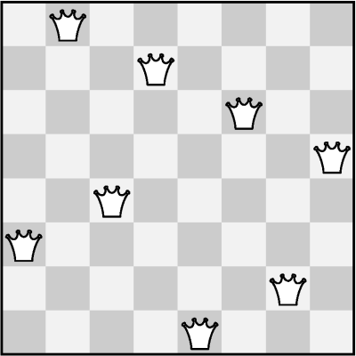
The "8 Queens" Puzzle
Write a program to find all
possible placements of
8 queens on a chessboard
So that no two queens
can attack each other
http://en.wikipedia.org/wiki/
Eight_queens_puzzle

Slide 40
Solving The "8 Queens" Puzzle
Find all solutions to "8 Queens Puzzle“
At each step:
Put a queen at
free position
Recursive call
Remove the queen
def put_queens(row):
if row == 8:
print_solution()
return
for col in range(0, 8):
if can_place_queen(row, col):
set_queen(row, col)
put_queens(row + 1)
remove_queen(row, col)

Slide 41
R || I
Recursion or Iteration?
When to Use and When to Avoid Recursion?

Slide 42
Performance: Recursion vs. Iteration
Recursive calls are slower
Parameters and return values travel through the stack
Good for branching problems
No function call cost
Creates local variables
Good for linear problems (no branching)
def fact(n):
if n == 0:
return 1
return n * fact(n - 1)
def fact(n):
result = 1
for i in range(1, n + 1):
result *= i
return result

Slide 43
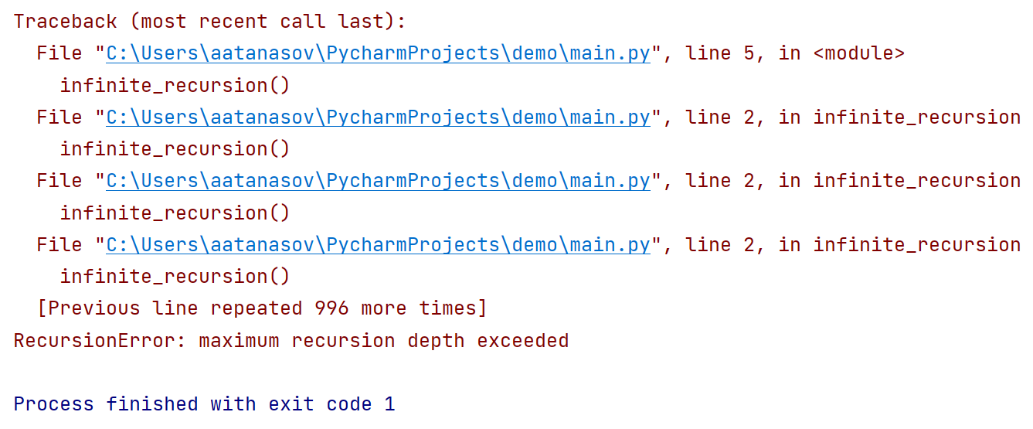
Infinite Recursion
Infinite recursion == a method calls itself infinitely
Typically, infinite recursion == bug in the program
The bottom of the recursion is missing or wrong
In Python / C# / Java / C++ causes "stack overflow" error

Slide 44
Recursion Can be Harmful!
When used incorrectly recursion could take too much memory and computing power
def calc_fib(number):
if number <= 1:
return 1
return calc_fib(number - 1) + calc_fib(number - 2)
print(calc_fib(10)) # 89
print(calc_fib(50)) # This will hang!

Slide 45
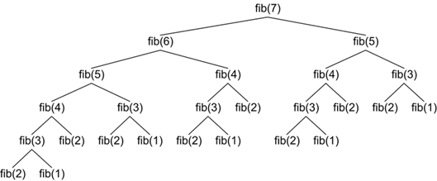
How the Recursive Fibonacci Calculation Works?
fib(n) makes about fib(n) recursive calls
The same value is calculated many, many times!

Slide 46
When to Use Recursion?
Avoid recursion when an obvious iterative algorithm exists
Examples: factorial, fibonacci numbers
Use recursion for combinatorial algorithms where:
At each step you need to recursively explore more than one possible continuation
Branched recursive algorithms

Slide 47

Summary
…
…
…
Algorithmic Complexity
Recursion
Backtracking
When to use recursion
When to use iteration

Slide 48
Questions?

Slide 49












SoftUni Diamond Partners

Slide 50


Educational Partners

Slide 51

License
This course (slides, examples, demos, exercises, homework, documents, videos and other assets) is copyrighted content
Unauthorized copy, reproduction or use is illegal
© SoftUni – https://about.softuni.bg/
© Software University – https://softuni.bg
Notes:
51

Slide 52
Software University – High-Quality Education, Profession and Job for Software Developers
softuni.bg
Software University Foundation
softuni.foundation
Software University @ Facebook
facebook.com/SoftwareUniversity
Software University Forums
forum.softuni.bg

